Slide 1
Escape Room Python Game
By orange-group-project1
23/04/23

Slide 2
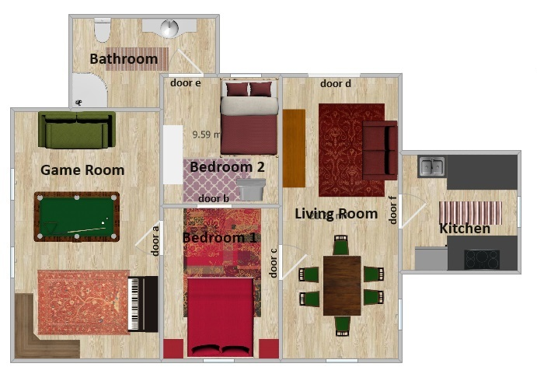
Outside
Play time = 3min
Play level = 3
Replayable

Slide 3
Development History
Discussed/Attempted/
Not impl.
Stage 2
Stage 1
Alpha Product Development
Objective: Develop a functional alpha version of the project.
Focus: Ensured basic functionality works as expected. Explored additional functionality
Refinement Phase
Objective: Improve existing features without adding new data types or functions.
Focus: Enhancing user experience and addressing any bugs or issues.
Future Adjustment
Incorporating images and voice
Time limits
Random room generation
Create puzzles and riddles

Slide 4
Why choose GIT?
Timer
Leaderboards
CSV export
Ease of use and readability
Additional puzzles/riddles
Additional Rooms
Additional Items
Examples: explore/examine. Superlative functions. Global counter

